Slide 1
Unit -5
Spring

Slide 2
Spring Framework
The Spring Framework is an open-source, powerful, lightweight, and widely used Java framework for building enterprise applications.
It simplifies enterprise application development by using techniques like Aspect-Oriented Programming (AOP), Plain Old Java Objects (POJO), and Dependency Injection (DI).
It provides alternatives to traditional Java APIs like JDBC, JSP, and Servlets.

Slide 3
Why Spring?
Traditional Java application:
Engine engine = new Engine();
Car car = new Car(engine);
Problems:
Classes create their own dependencies.
Tight coupling.
Difficult to replace implementations.
Difficult to test.
Object creation is handled manually.

Slide 4
Features of Spring Framework
Dependency Injection: Dependency Injection is a design pattern where the Spring container automatically provides the required dependencies to a class, instead of the class creating them itself. This promotes loose coupling, easier testing, and better maintainability by decoupling the object creation and usage.
Spring MVC: It is a powerful framework for building web applications that follow the Model-View-Controller pattern.

Slide 5
Spring core Architecture
Application
↓
Spring Container
↓
Beans
↓
Dependency Injection
↓
Business Logic

Slide 6
Inversion of Control (IOC) Container
Inversion of Control (IoC) is a design principle used in object-oriented programming where the control of object creation and dependency management is transferred from the application code to an external framework or container.
This reduces the complexity of managing dependencies manually and allows for more modular and flexible code.
In Spring framework there are mainly two types of IOC Container which are listed below:

Slide 7
Inversion of Control (IOC) Container
1. BeanFactory: BeanFactory is the simplest container and is used to create and manage beans. It is a basic container that initializes beans lazily (i.e., only when they are needed). It is typically used for lightweight applications where the overhead of ApplicationContext is not required.
Example :-
<bean id=”car” class=”com.example.Car” scope=“singleton”/>
This will create a Car bean inside the IoC container, which will be initialized when requested.

Slide 8
Bean Scopes
Scope | Meaning
singleton | One bean instance per Spring container
prototype | New instance whenever requested
request | One instance per HTTP request
session | One instance per HTTP session
application | One instance per ServletContext
websocket | One instance per WebSocket

Slide 9
Bean LifeCycle
Bean Definition
↓
Object Instantiation
↓
Dependency Injection
↓
Initialization
↓
Bean Ready
↓
Application Running
↓
Destruction

Slide 10
Inversion of Control (IOC) Container
2. Application Context: ApplicationContext is an advanced container that extends BeanFactory and provides additional features like internationalization support, event propagation, and AOP (Aspect-Oriented Programming) support. The ApplicationContext is preferred in most Spring applications because of its enhanced features.
Example:-
@ComponentScan("com.example")
This will scan the specified package for annotated components beans like @Component, @Service, @Repository, etc.

Slide 11
Dependency Injection
Dependency Injection is a design pattern used in software development to implement Inversion of Control.
It allows a class to receive its dependencies from an external source rather than creating them within the class. This reduces the dependency between classes and makes the system more maintainable.
Types of Dependency Injection
Constructor Injection
Setter Injection
Field Injection

Slide 12
Constructor Injection
In constructor injection, the dependent object is provided to the class via its constructor. The dependencies are passed when an instance of the class is created.
Example:-
@Component
public class Engine {
}

Slide 13
Constructor Injection
@Component
public class Car {
  private Engine engine;
  @Autowired
  public Car(Engine engine) {
  this.engine = engine;
}}

Slide 14
Setter Injection
In setter injection, the dependent object is provided to the class via a setter method after the class is instantiated. This allows you to change the dependencies dynamically.
Example:-
@Component
public class Car {
  private Engine engine;
  @Autowired
  public void setEngine(Engine engine) {
  this.engine = engine;
}}

Slide 15
Field Injection
In field injection, the dependent object is directly injected into the class through its fields. It is done using framework like Spring(via annotations). The Dependency Injection automatically injects the dependency without requiring explicit constructor or setter methods.
Example:-
public class Car {
@Autowired
private Engine engine;
}

Slide 16
Spring Annotation
@Component: Marks a class as a Spring bean, allowing Spring to automatically detect and manage it during classpath scanning.
@Autowired: Automatically injects dependencies into a class. It can be used on fields, constructors, or methods, allowing Spring to resolve and inject the required beans.
@Bean: Defines a Spring bean explicitly within a configuration class. This is used to create and configure beans that are not automatically detected by classpath scanning.
@Configuration: Indicates that a class contains bean definitions and acts as a source of bean configuration. It is used to mark a class as a configuration class that contains methods annotated with @Bean to define beans.

Slide 17
Injecting Inner Beans
An inner bean is a bean defined inside another bean's dependency configuration.
Example:
<bean id="car" class="com.example.Car">
<property name="engine">
<bean class="com.example.Engine"/>
</property>
</bean>

Slide 18
Injecting Collection
Spring can inject List, Set, Map etc.
Example:
<bean id="student" class="com.example.Student">
<property name="subjects">
<list>
<value>Java</value>
<value>Spring</value>
<value>Database</value>
</list>
</property>
</bean>

Slide 19
Event Handling
Spring can handle any events.
Example:
@Component
public class StudentEventListener {
@EventListener
public void handle(StudentRegisteredEvent event) {
System.out.println("Student registered!");
}
}

Slide 20
Spring MVC(Model-View-Controller)
The Spring MVC Framework follows the Model-View-Controller architectural design pattern, which works around the Front Controller, i.e., the Dispatcher Servlet. The Dispatcher Servlet handles and dispatches all incoming HTTP requests to the appropriate controller.
It uses @Controller and @RequestMapping as default request handlers. The @Controller annotation defines that a particular class is a controller. The @RequestMapping annotation maps web requests to Spring Controller methods.

Slide 21
Spring MVC(Model-View-Controller)
The terms model, view, and controller are defined as follows:
Model: The Model encapsulates the application data.
View: The View renders the model data and generates HTML output that the client’s browser can interpret.
Controller: The Controller processes the user requests and passes them to the view for rendering.

Slide 22
Advantages of Spring MVC
Separation of Concerns – Clean division of Model, View, and Controller.
Loose Coupling – Uses Dependency Injection to reduce tight coupling.
Flexible View Technology – Works with JSP, Thymeleaf, PDFs, Excel, etc.
REST Support – Easily create RESTful web services.
Built-in Exception Handling – Provides default error handling.

Slide 23
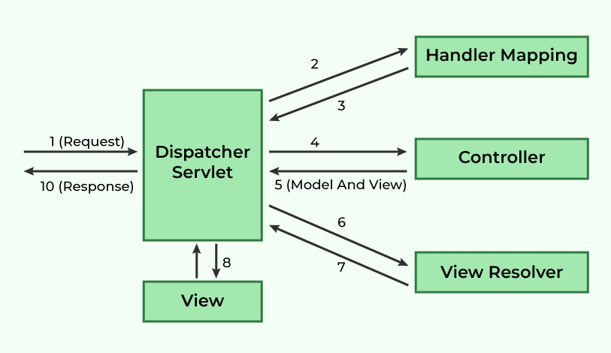
Spring MVC Control Flow Diagram

Slide 24
Spring MVC Work Flow
All incoming requests are intercepted by the DispatcherServlet, which works as the front controller.
The DispatcherServlet retrieves an entry of handler mapping from the configuration file and forwards the request to the controller.
The controller processes the request and returns an object of ModelAndView.
The DispatcherServlet checks the entry of the view resolver in the configuration file and invokes the appropriate view component.

Slide 25
Dispatcher Servlet
The Dispatcher Servlet is the front controller that manages the entire HTTP request and response handling process. Now, the question is: What is a Front Controller? It is quite simple, as the name suggests:
When any web request is made, it first goes to the Front Controller, which is the Dispatcher Servlet.
The Front Controller stands first, which is why it is named as such. After the request reaches it, the Dispatcher Servlet determines the appropriate controller to handle the request.
Then, it dispatches the HTTP request to the specific controller.

Slide 26
Handler Mapping
Handler Mapping is responsible for mapping a URL request to a controller.
Example:-
@Controller
public class HomeController {
@RequestMapping("/home")
public String home() {
return "homepage";
}}
DispatcherServlet checks HandlerMapping and finds home() method.

Slide 27
Http Handler Mapping
Http Get Request
@GetMapping("/users")
public String fetchUsers() {
return "userList";
}
Http Post Request
@PostMapping("/register")
public String createUser() {
return "success";
}

Slide 28
Passing Parameters in Request Mapping
1. Path Variables (@PathVariable)
Used to capture values from the URL path
@GetMapping("/user/{id}")
public String getUserById(@PathVariable("id") int userId, Model model) {
model.addAttribute("userId", userId);
return "userDetails";}
2.Query Parameters (@RequestParam)
Used to capture values from URL query strings (?key=value).
@GetMapping("/search")
public String search(@RequestParam("q") String query, Model model) {
model.addAttribute("query", query);
return "searchResults";}

Slide 29
View in Spring MVC
A View is the part of an MVC application that displays data to users.
It can be a JSP page, Thymeleaf template, PDF, or Excel document.
The Controller passes data to the view, which renders it for the user.
Example:
A user visits http://localhost:8080/welcome.
The controller processes the request and returns a view (welcome.jsp)..

Slide 30
View Resolver
Spring MVC uses View Resolvers to determine which view to render.
View resolvers map logical view names (e.g., "home") to actual files (e.g., /WEB-INF/views/home.jsp).
Example :-
Controller returns a logical view name: return "home";.
View Resolver maps "home" to /WEB-INF/views/home.jsp.
Spring renders the home.jsp page.

Slide 31
Passing Data to Views using Model
Model is an interface used to pass attributes to the view.
It is typically used in a controller method with @RequestMapping.
You add data using model.addAttribute("key", value);.
The view name is returned separately as a String.
@Controller
public class MyController {
@GetMapping("/example")
public String example(Model model) {
model.addAttribute("message", "Hello from Model!");
return "viewName";
}}

Slide 32
Passing Data to Views using Model and View
ModelAndView (class) combines both the model data and the view name into a single object.
You set the view name using setViewName("viewName").
You add data using addObject("key", value).
@Controller
public class MyController {
@GetMapping("/example")
public ModelAndView example() {
ModelAndView mav = new ModelAndView();
mav.setViewName("viewName");
mav.addObject("message", "Hello from ModelAndView!");
return mav;}}

